Slide 1

Temporal Link Prediction Model for Weighted Dynamic Networks
Capstone Project Phase B
23-1-R-15
Students:
Lior Karish | Tal-Chen Ben-Eliyahu
Supervisors:
Dr. Renata Avros
Prof. Zeev Volkovich
1

Slide 2
Table Of Content
1
2
5
Project Aim
Results
Model Overview
6
Demonstration Clip
3
7
Testing Plan and UML
Prediction Process
4
8
GUI
Conclusions
2

Slide 3



Project Aim
The proposed model is a non-linear temporal link prediction model for weighted dynamic of articles.
The primary objective of this project is to accurately predict the validity of links present within a given article.
To improve the prediction, the GCN-GAN model is utilized.
The model predicts a link between articles.
Preserved the topological structure and dynamic prediction of the weighted links.
3

Slide 4
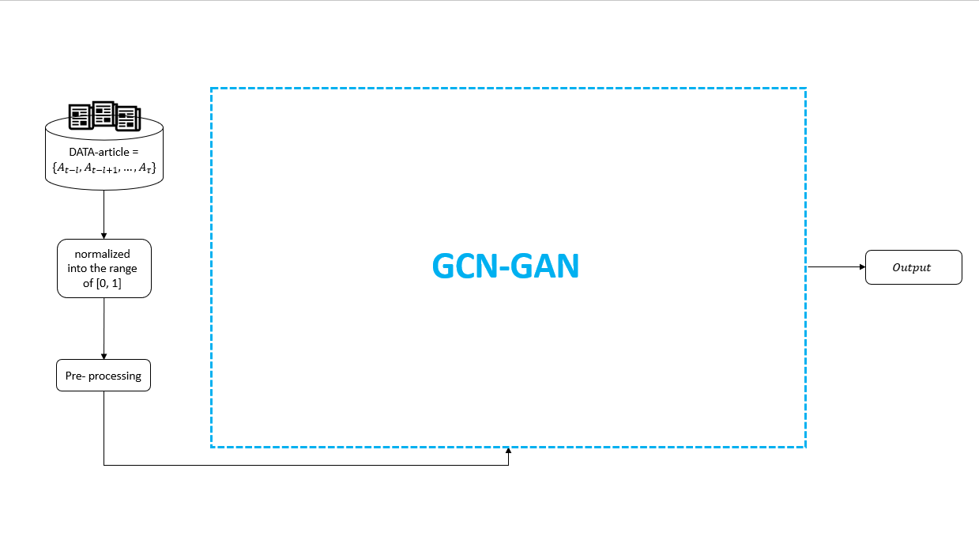
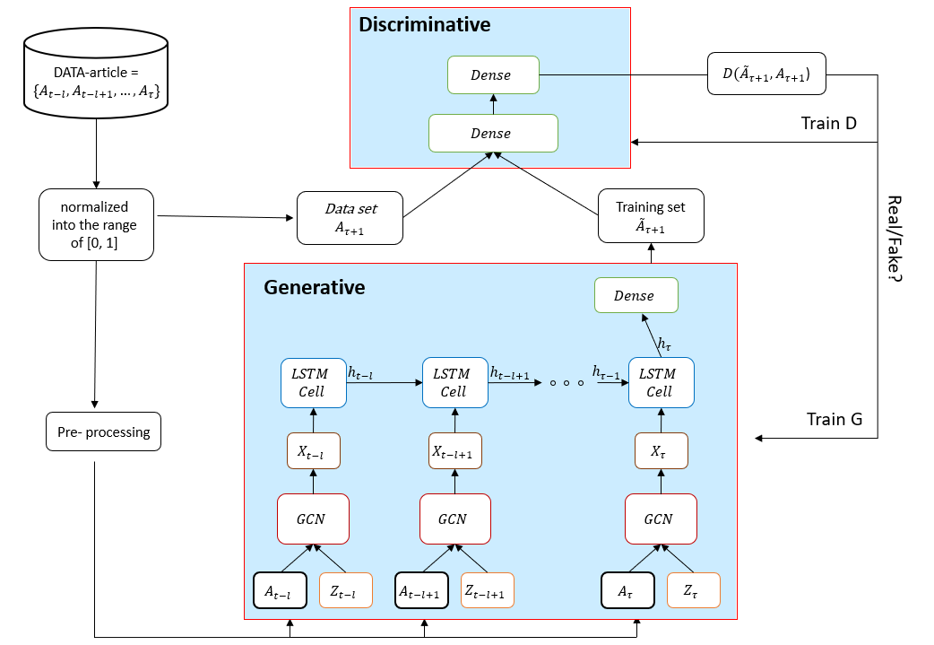
Model Overview
The input is a set of articles that are represented as adjacency matrixes.
The edge between two nodes represents the relationships between pairs of nodes.
Each adjacency matrix is normalized into the range [0,1].
Performs pre-processing of the dataset.
The dataset enters GCN-GAN and outputs the weighted graph of the dynamic prediction.
4

Slide 5
Model Overview GCN-GAN
Dataset of articles
Normalization and Pre-processing
Generative network G:
Discriminative network D:
An adjacency matrix and noise are fed to the GCN.
The output of GCN and the output of the previous snapshot are fed into the LSTM cell.
Finally, the last output of the LSTM cell is fed into the dense layer.
The generative result and the dataset are fed into the discriminative.
D determines whether the generated result or the dataset is real.
5

Slide 6
Model Overview GCN-GAN
Dataset of articles
Normalization and Pre-processing
Generative network G:
Discriminative network D:
An adjacency matrix and noise are fed to the GCN.
The output of GCN and the output of the previous snapshot are fed into the LSTM cell.
Finally, the last output of the LSTM cell is fed into the dense layer.
The generative result and the dataset are fed into the discriminative.
D determines whether the generated result or the dataset is real.
6

Slide 7
Model Overview GCN-GAN
Dataset of articles
Normalization and Pre-processing
Generative network G:
Discriminative network D:
An adjacency matrix and noise are fed to the GCN.
The output of GCN and the output of the previous snapshot are fed into the LSTM cell.
Finally, the last output of the LSTM cell is fed into the dense layer.
The generative result and the dataset are fed into the discriminative.
D determines whether the generated result or the dataset is real.
6

Slide 8
Model Overview GCN-GAN
Dataset of articles
Normalization and Pre-processing
Generative network G:
Discriminative network D:
An adjacency matrix and noise are fed to the GCN.
The output of GCN and the output of the previous snapshot are fed into the LSTM cell.
Finally, the last output of the LSTM cell is fed into the dense layer.
The generative result and the dataset are fed into the discriminative.
D determines whether the generated result or the dataset is real.
6

Slide 9
Model Overview GCN-GAN
Dataset of articles
Normalization and Pre-processing
Generative network G:
Discriminative network D:
An adjacency matrix and noise are fed to the GCN.
The output of GCN and the output of the previous snapshot are fed into the LSTM cell.
Finally, the last output of the LSTM cell is fed into the dense layer.
The generative result and the dataset are fed into the discriminative.
D determines whether the generated result or the dataset is real.
6

Slide 10

Prediction Process
Initial Dataset Validation:
iCite Dataset
Dataset Reduction Challenge
Multiple Snapshots for Prediction
Applied the model to the UCSB dataset, confirming its accuracy and proficiency in generating high-quality weighted links.
7

Slide 11
Prediction Process
Applied the model to the UCSB dataset, confirming its accuracy and proficiency in generating high-quality weighted links.
Initial Dataset Validation:
iCite Dataset:
Dataset Reduction Challenge Multiple Snapshots for Prediction
Utilize the iCite dataset, providing extensive information on articles and their references, including metadata such as author, publication year, and subject.
7

Slide 12
Prediction Process
Applied the model to the UCSB dataset, confirming its accuracy and proficiency in generating high-quality weighted links.
Initial Dataset Validation:
iCite Dataset:
Dataset Reduction Challenge
Multiple Snapshots for Prediction
Utilize the iCite dataset, providing extensive information on articles and their references, including metadata such as author, publication year, and subject.
Faced challenges due to the large size of the iCite dataset.
Developed an algorithm to reduce the dataset based on specific conditions.
Generated a metadata file capturing the source and target nodes, representing the articles and their references, and preserving the overall topology.
7

Slide 13
Prediction Process
Applied the model to the UCSB dataset, confirming its accuracy and proficiency in generating high-quality weighted links.
Initial Dataset Validation:
iCite Dataset:
Dataset Reduction Challenge
Multiple Snapshots for Prediction
Utilize the iCite dataset, providing extensive information on articles and their references, including metadata such as author, publication year, and subject.
Faced challenges due to the large size of the iCite dataset.
Developed an algorithm to reduce the dataset based on specific conditions.
Generated a metadata file capturing the source and target nodes, representing the articles and their references, and preserving the overall topology.
Lack of snapshots from the iCite dataset.
Randomly assigned weights to edges in specific graph snapshots during the prediction process.
7

Slide 14
Prediction Process
Identifying unstable edges, which are infrequently predicted and considered unreliable indicators of a lack of connection between articles.
8

Slide 15
Prediction Process
Identifying unstable edges, which are infrequently predicted and considered unreliable indicators of a lack of connection between articles.
Developing code to predict unstable edges, aiming to address the issue and improve prediction accuracy.
8

Slide 16
Prediction Process
Identifying unstable edges, which are infrequently predicted and considered unreliable indicators of a lack of connection between articles.
Developing code to predict unstable edges, aiming to address the issue and improve prediction accuracy.
Challenge of Determining Error Threshold:
Determining the error percentage for identifying unstable edges.
During the training process, calculated the difference between predicted and ground truth edges, using a threshold of 0.01.
8

Slide 17
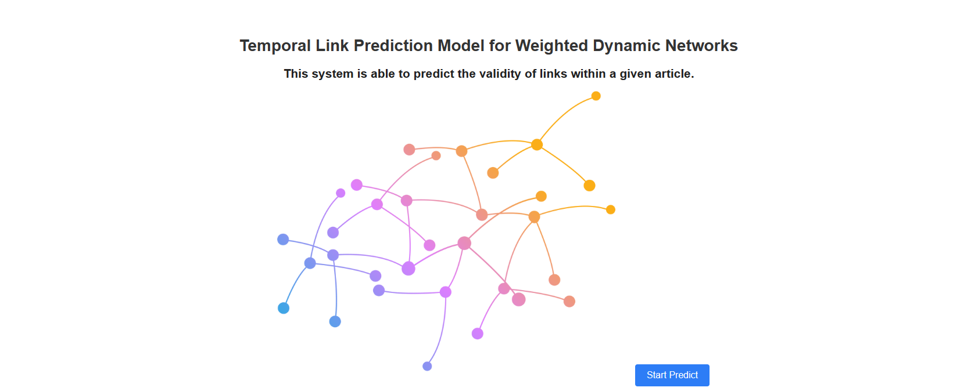
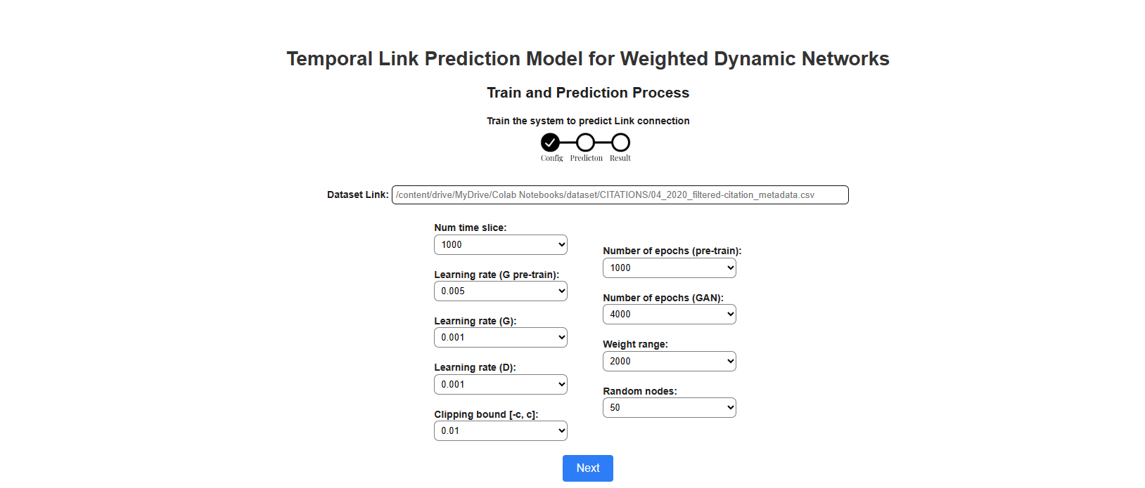
Prediction Process
Identifying unstable edges, which are infrequently predicted and considered unreliable indicators of a lack of connection between articles.
Developing code to predict unstable edges, aiming to address the issue and improve prediction accuracy.
Challenge of Determining Error Threshold:
Evaluating Prediction Accuracy:
Determining the error percentage for identifying unstable edges.
During the training process, calculated the difference between predicted and ground truth edges, using a threshold of 0.01.
Calculated the average of incorrect predictions for each edge.
Finding the optimal threshold required.
8

Slide 18
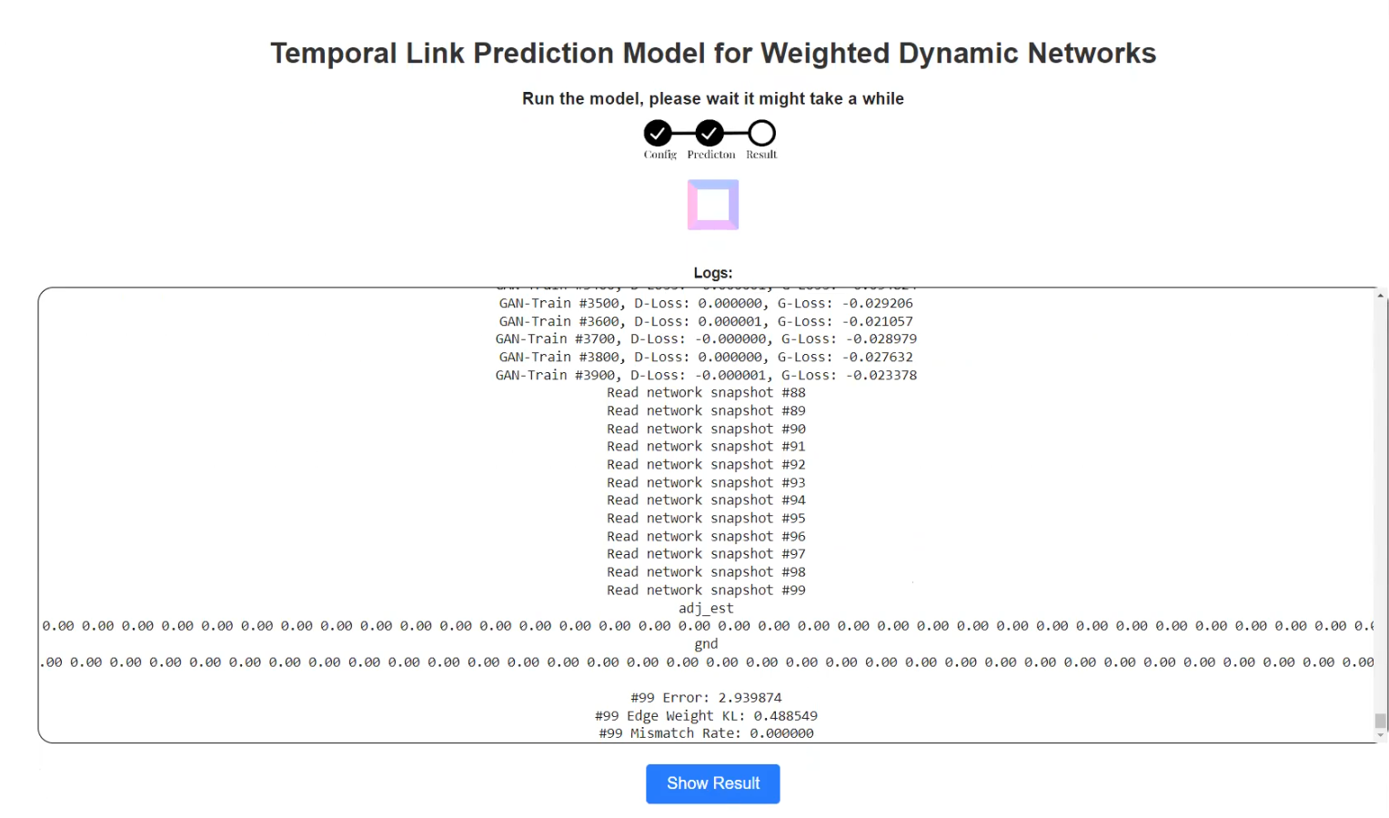
GUI
9

Slide 19
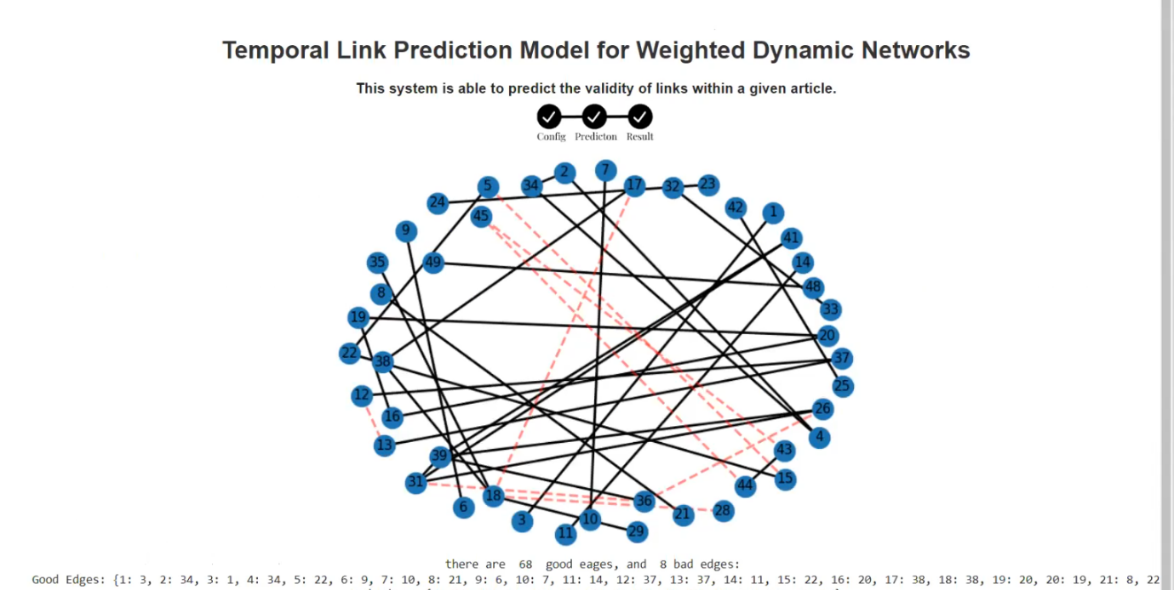
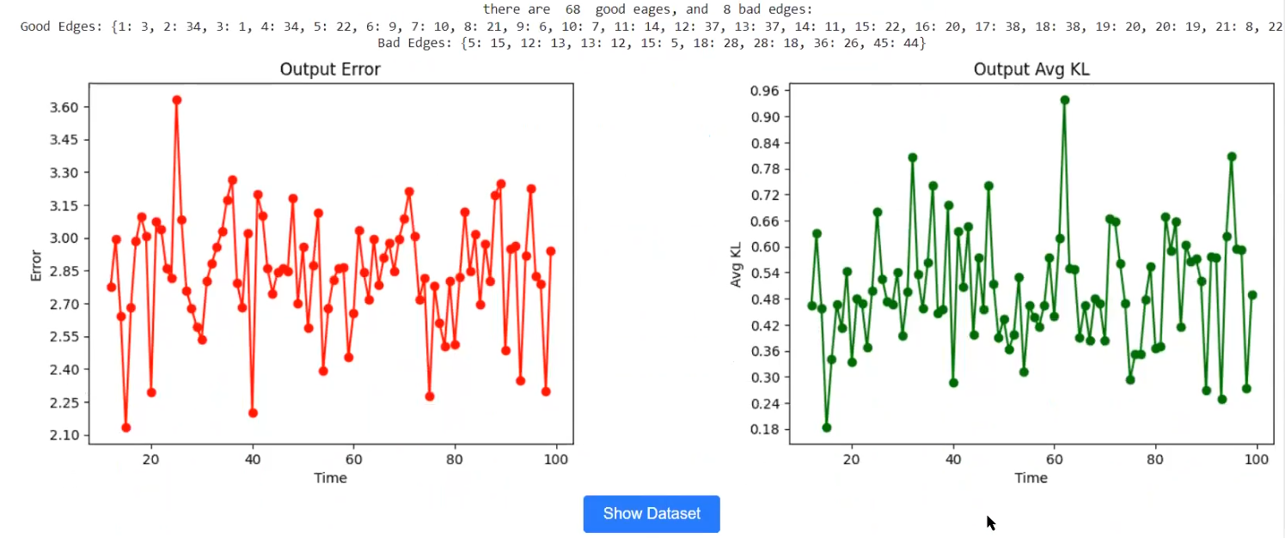
GUI
10

Slide 20
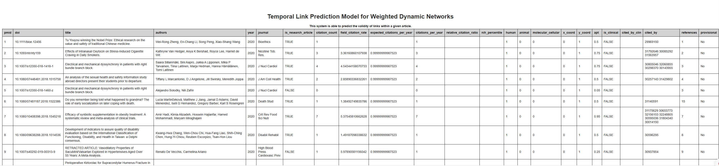
GUI
11

Slide 21
GUI
12

Slide 22
Results
In this research, the model's predictive success is evaluated based on three types of outcomes:
Output Error - Refers to the difference between the desired output and the actual output produced by a model.
Avg KL - Is used as a metric to evaluate the dissimilarity or discrepancy between predicted and target probability distributions. It helps to assess the quality of models and the accuracy of their predictions.
Graph - The graph represents a visual result of the edges that the model was able to predict correctly and the edges that the model was able to predict as unstable and unreliable. The graph is generated utilizing NetworkX's visualization capabilities, which enable the creation of visual representations for the graph.
13

Slide 23
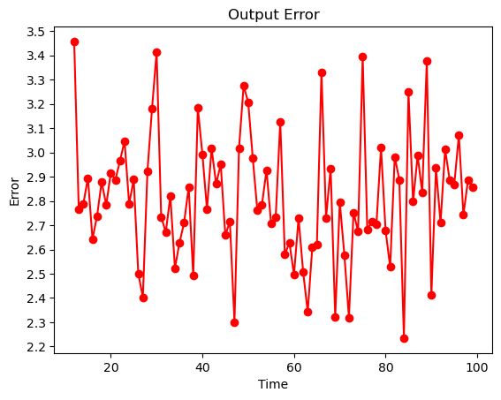
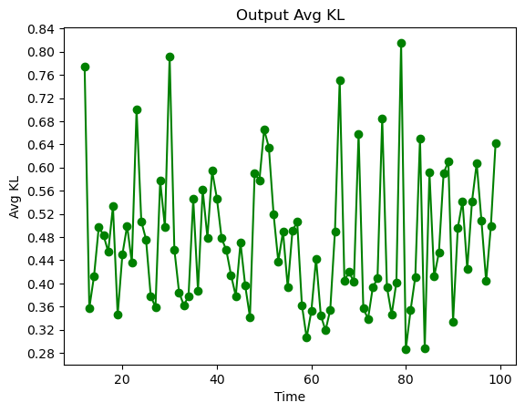
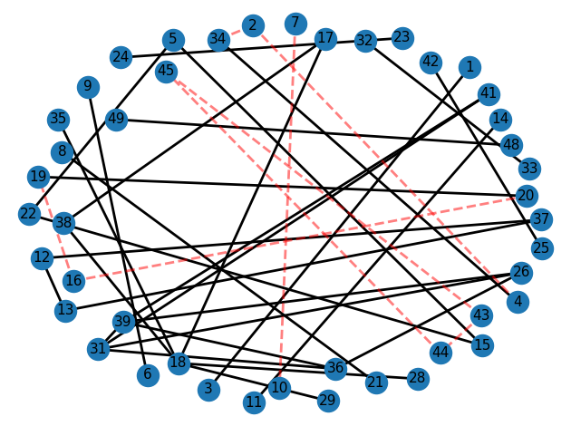
Results time num=100, error=0.005
The results are:
Output Error is in range 2.2 to 3.5.
The Avg KL is in range 0.28 to 0.84.
Good edges > Bad edges
14

Slide 24
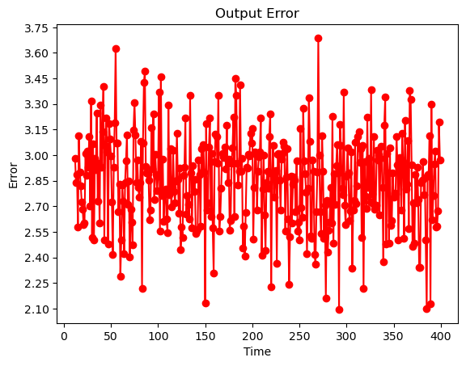
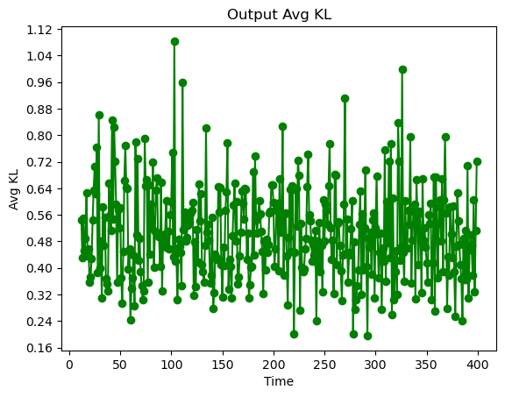
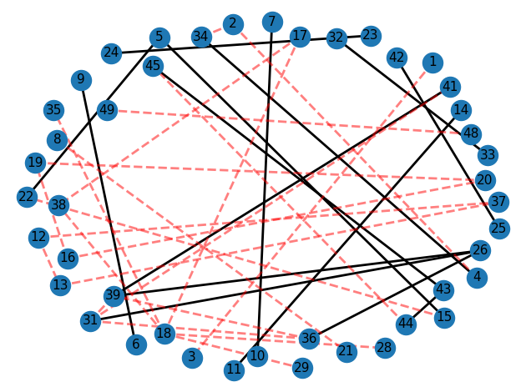
Results time num=400 , error=0.005
The results are:
Output Error is in range 2.1 to 3.75.
The Avg KL is in range 0.16 to 1.2.
Good edges < Bad edges
15

Slide 25
Results
The graph reveals a significant disparity between the number of well-predicted edges and those that were inaccurately predicted as much as the value of time_num variable is increase.
At time_num = 100, the average KL value obtained was 0.475, while at time_num = 400, the average KL value obtained was 0.503. A larger value suggests a greater dissimilarity or divergence between the two networks of the generator and the discriminator.
The charts demonstrate that the average output error is approximately 2.8 when time_num = 100 and around 2.85 when time_num = 400.
16

Slide 26
Demonstration Clip
17

Slide 27

14

Slide 28
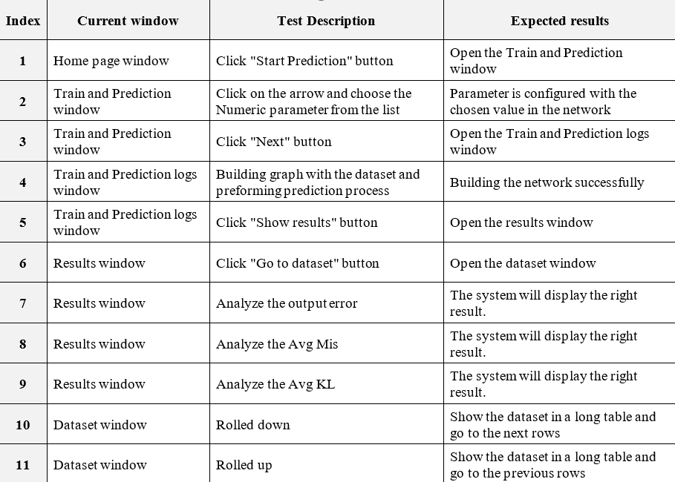
Testing Plan
19

Slide 29
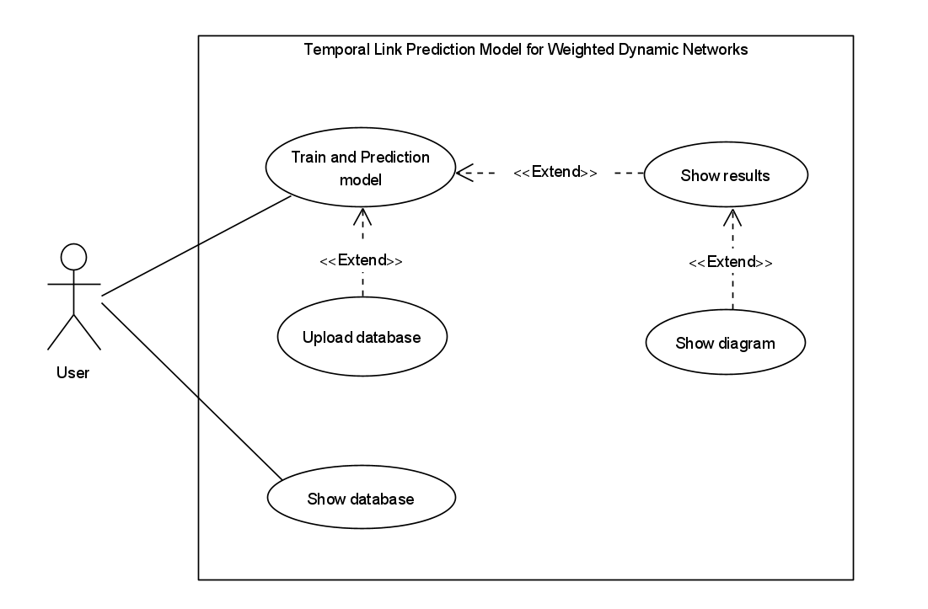
UML –Use Case Diagram
20

Slide 30
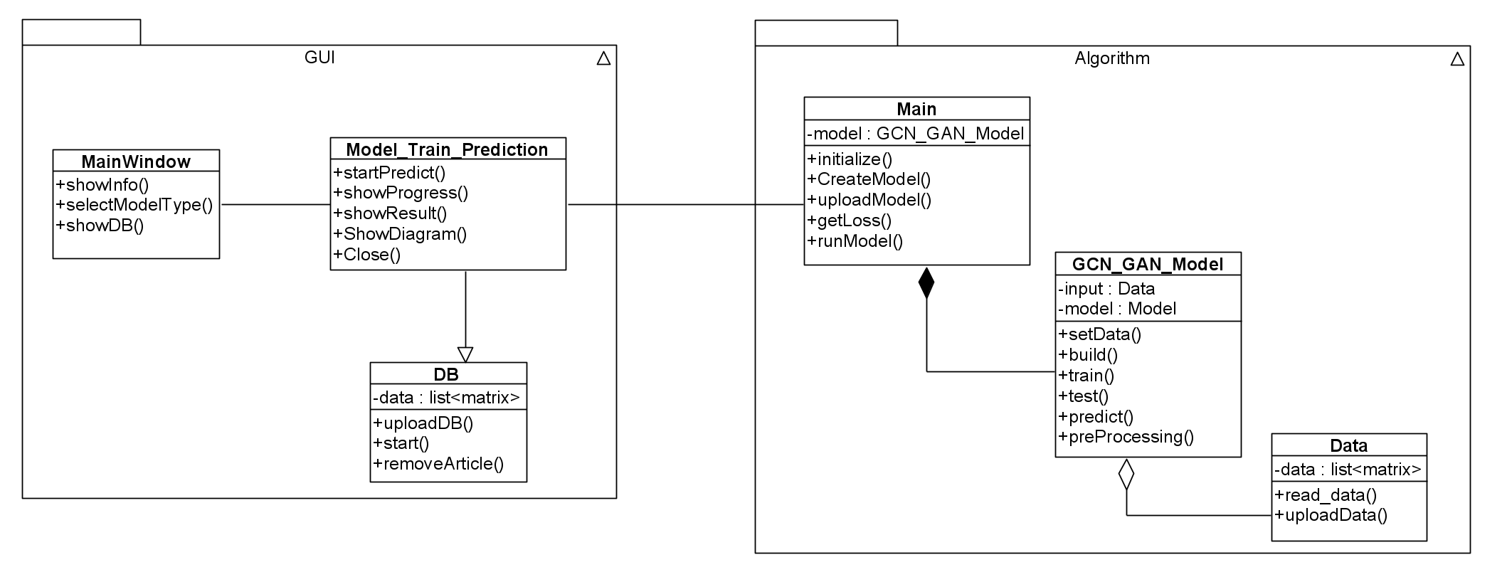
UML –Class Diagram
21

Slide 31

Conclusions
The project aim is to determine whether the links in each article are meaningful and relevant based on the database of articles.
The results obtained from applying the model to the UCSB dataset demonstrate its ability to generate weighted links of high quality, indicating the reliability of the article that served as the basis for our work.
Utilizing the ICITE metadata dataset produced favorable outcomes in terms of accurately predicting links between articles.
Ways to improve:
Acquiring additional data.
Monitor the model’s performance during prediction process.
22

Slide 32

Thank You For Listening!
23

